Slide 1
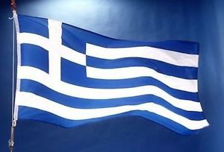
Ms. Maria-Ioanna Verras
Greek teacher

Slide 2
About me
I have graduated from Moraitis School and from the National and Kapodistrian University of Athens, department of Psychology in Greece with honors and this is my 5th year teaching Greek language and culture in Plato Academy Charter Schools – Plato Academy Palm Harbor.
Contact me: verrasm@platoacademy.net
Website: verrasm.weebly.com

Slide 3
Greek Language Syllabus
Students will begin to communicate in all four-skill areas:
Reading
Writing
Speaking
Listening
By integrating language, culture, fine art, music, dance, food and family customs in the Greek course, we will explore the wide variety of the Greek-speaking world’s perspectives.

Slide 4
Class-required materials
The students need to bring to class:
i) An A4 folder for papers and worksheets.
ii) A notebook (spiral or regular) containing more than 50 sheets.
Note: Students are responsible for being organized and bringing their materials in class.

Slide 5
Books for 1st Grade
Gia Hara! (Γεια Χαρά!) Greek 123 Level K Primary Student’s Book
Gia Hara! (Γεια Χαρά!) Greek 123 Level K Primary Activity Book

Slide 6
Weight: Grade Distribution (1st Grade)
Participation in Class (Reading, Listening, Writing, Speaking): 100%
Total: 100%

Slide 7
Grade posting frequency
Participation grades for all Grades will be posted at the end of every week.
Final - average grades for all Grades will be posted at the end of every quarter along with a conduct grade.

Slide 8
Classroom rules
Students are expected to:
Be in class on time.
Stay in their seats.
Respect their classmates and their teachers.
Raise their hands if they want to say something.
Listen carefully.
Keep desks and classroom clean.

Slide 9
Let’s have a great 2021 – 2022 school year!

